Slide 1
WEB APPLICATION DEVELOPMENT TRAINING
PHP, XML AND AJAX WEEKEND CLASS
June 10, 2017

Slide 2
AJAX
AJAX, is a web development technique for creating interactive web applications.
Although X in Ajax stands for XML, JSON is used more than XML nowadays because of its many advantages such as being lighter and a part of JavaScript.
Both JSON and XML are used for packaging information in Ajax model.
With AJAX, you can:
  Update a web page without reloading the page
  Request data from a server - after the page has loaded
  Receive data from a server - after the page has loaded
  Send data to a server - in the background

Slide 3
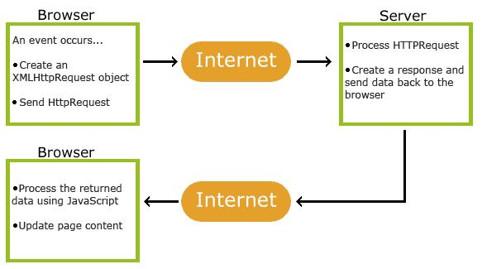
How AJAX Works

Slide 4
AJAX
The keystone of AJAX is the XMLHttpRequest object
Recall that the protocol that run on the WWW is the HTTP.
Most browsers allows you to generate and send HTTP request by using the XMLHttpRequest object.
You simply create an instance of the object, open a URL, and send the request
The HTTP status of the result, as well as the result's contents, are available in the request object when the transaction is completed
You can then use Javascript to update the page.

Slide 5
AJAX
With the above process, you need not leave the current page in order to send request to the browser and also get response! – This is the principle of AJAX
Synchronous and Asynchronous requests: A request that is executed synchronously waits for the event to finish executing before starting /moving to other events while the one executed asynchronously can execute many events at the same time.
AJAX requests are executed asynchronously.

Slide 6
Jquery AJAX
Aside the native way of sending requests to the server, jquery also provides a way of sending AJAX requests to the server.
Some common AJAX methods are examined below:
.load() Method - The load() method loads data from a server and puts the returned data into the selected element
Syntax is: $(selector).load(url,data,function(response,status,xhr))
Notes:
The required URL parameter specifies the URL you wish to load.
The optional data parameter specifies a set of querystring key/value pairs to send along with the request.
The optional callback parameter is the name of a function to be executed after the load() method is completed.

Slide 7
The load method
The optional callback parameter specifies a callback function to run when the load() method is completed. The callback function can have different parameters:
response- contains the resulting content if the call succeeds
status - contains the status of the call
xhr - contains the XMLHttpRequest object, which of course can be used to access the properties and methods of the XMLHttpRequest object.

Slide 8
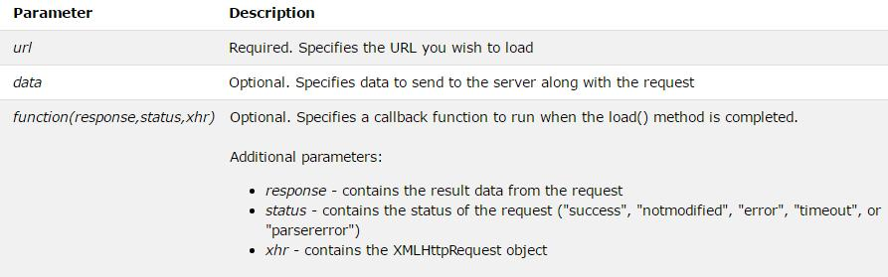
The .load Method
Notes:
The data to be sent can be in the form { name:"Donald", town:"Ducktown" } – if in object form , POST is used to retrieve the data, if in string form, GET is used

Slide 9
jQuery $.get()
The jQuery get() and post() methods are used to request data from the server with an HTTP GET or POST request.
Syntax is as follows:
$.get(URL,data,function(data,status,xhr),dataType)
The required URL parameter specifies the URL you wish to request.
The optional callback parameter is the name of a function to be executed if the request succeeds. function
Notes:
The required URL parameter specifies the URL you wish to request.
The optional callback parameter is the name of a function to be executed if the request succeeds

Slide 10
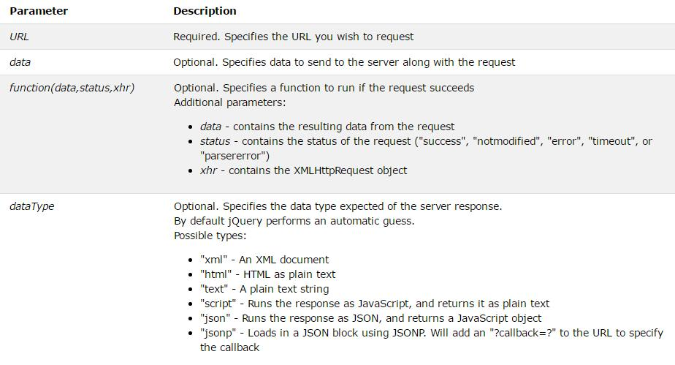
The $.get() method
Notes:
The data being sent can be in the form: { name:"Donald", town:"Ducktown" }

Slide 11
jQuery $.post()
Syntax:
$(selector).post(URL,data,function(data,status,xhr),dataType)
The required URL parameter specifies the URL you wish to request.
The optional data parameter specifies some data to send along with the request.
The optional callback parameter is the name of a function to be executed if the request succeeds.
The callback function has 2 parameters: status and the data being returned from the request.
Notes:
The data are shown as name:value pair

Slide 12
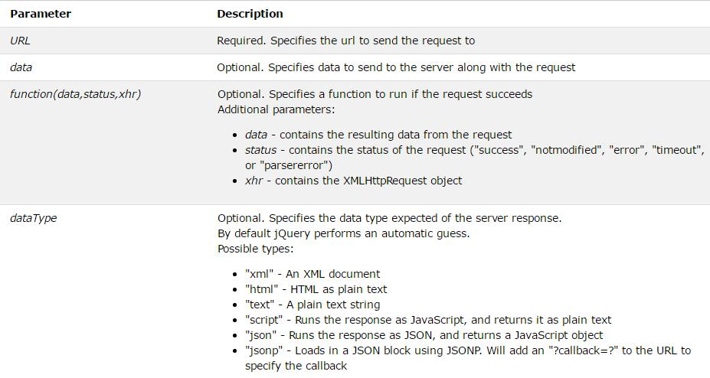
The $.Post() method

Slide 13
Simple Example of the $.post()
$("#mia").click(function(){
$.post("test.php",
{
user: $("#username").val(),
city: "Lagos"
},
function(data, status){
alert("Data: " + data + "\nStatus: " + status);
});
});

Slide 14
The $.ajax() Method
The ajax() method is used to perform an AJAX (asynchronous HTTP) request
Syntax is : $.ajax({name:value, name:value, ... }) URL can also come as the first parameter wherein the other options specified in the name:value pair will be applied on the URL, if omitted, the ajax call will be applied to the current page
The $.ajax() function is what every function discussed in the previously mentioned article calls behind the scene using a preset configuration
The list of the options accepted by this function is very long

Slide 15
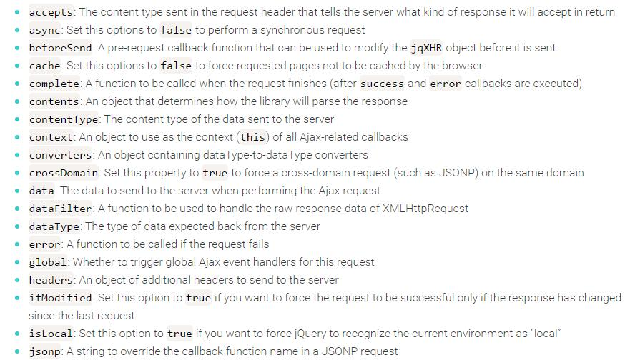

Slide 16
The $.ajax() Method
success: A function to be called if the request succeeds
timeout: A number that specifies a timeout (in milliseconds) for the request
type: The type of request to make, which can be either “POST” or “GET”
url: A string containing the URL to which the request is sent
xhr: A callback for creating the XMLHttpRequest object
Refer to http://api.jquery.com/jquery.ajax/ for a complete list of the $ajax options

Slide 17
Plugins
jQuery Validation Plugin
ajaxSubmit
ajaxForm

Slide 18
Outline - READ HOW TO:
AJAX File Upload
AJAX Comment Posting
Find username if it exists
Adding animation / loading..

Slide 19
Returning Array Values from the Server
There are times when you want to return multiple values.
The server can return an array value as follows: json_encode(); $res = array(‘fullname’=>’Abiola’,’age’=>12)
In the javascript, the success callback function can retrieve the data as an array.
success: function(response){
var x = response.fullname ; var y = response.age
}

Slide 20
JSON
JSON stands for JavaScript Object Notation.
JSON is a syntax for storing and exchanging data.
JSON is text, written with JavaScript object notation
JSON and XML are human readable formats and are language independent. They both have support for creation, reading and decoding in real world situations

Slide 21
JSON
When exchanging data between a browser and a server, the data can only be text.
JSON makes it possible to store JavaScript objects as text
We can also convert any JSON received from the server into JavaScript objects
If you have data stored in a JavaScript object, you can convert the object into JSON, and send it to a server
If you receive data in JSON format, you can convert it into a JavaScript object:
Its wide acceptability is in the fact that it can be used as a data format by any programming language.

Slide 22
JSON
JSON data is written as name/value pairs.
A name/value pair consists of a field name (in double quotes), followed by a colon, followed by a value: Example "name":"John“
JSON is parsed into a ready-to-use JavaScript object.
JSON is faster than XML in AJAX

Slide 23
JSON Functions
JSON.parse() - converts a string, written in JSON format, into native JavaScript objects
Objects in PHP can be converted into JSON by using the PHP function json_encode():
Arrays in PHP will also be converted into JSON when using the PHP function json_encode()
Convert into an object, using the PHP function json_decode()
Notes:
$myArr = array("John", "Mary", "Peter", "Sally");
$myJSON = json_encode($myArr);
echo $myJSON;

Slide 24
JSON Format
JSON storing array is:
{"employees":[ "John", "Anna", "Peter" ] }
JSON storing boolean is:
{ "sale":true }
JSON storing objects is:
{"employee":{ "name":"John", "age":30} }
JSON storing string must be double quotes
{ "name":"John" }
JSON storing number (int or float)
{ "age":30 }

